Slide 1
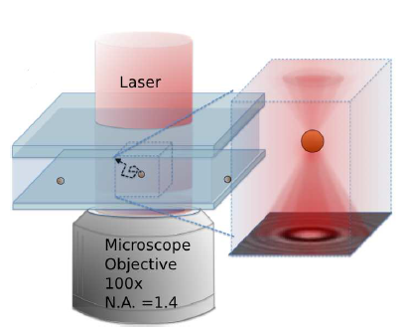
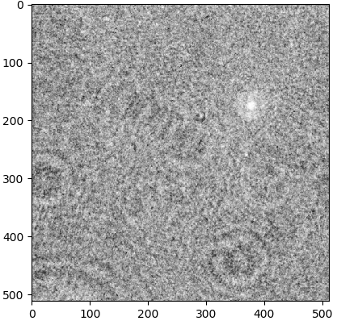
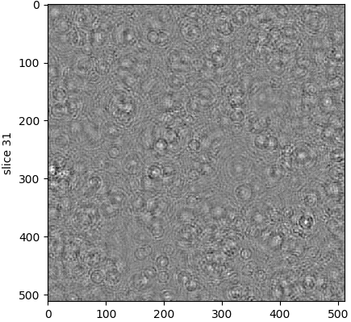
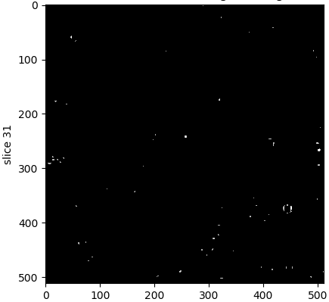
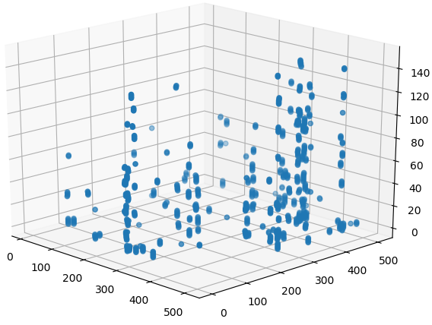
Holography Erick Rodriguez Supervisor: Dr. Laurence Wilson
Background
Overview
1. Video Acquisition
2. Rayleigh-Sommerfeld Propagator
3. Z-Gradient Stack
4. Particle Tracking
Record movies of swimming bacteria.
Optical volume reconstruction. 2D→3D
Use sobel-type filter for Z coordinate calculation.
3D tracking.
Filtering.
Raw frame #1
Reconstructed field at z=310 µICRONS
Study predatory bacteria.
Biophysics laboratory has an optical device to capture videos of microorganisms movement.
Videos are 2D.
Video processing → optical reconstruction → particle 3D tracking
LabVIEW → Python
Particle positions at height z=310 mICRONS
Particle position in 3D in frame #1

Slide 2
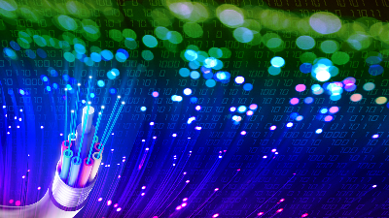

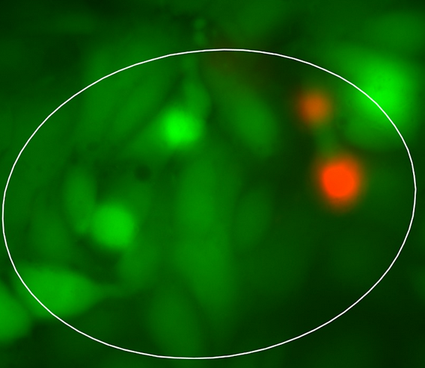
Future work
Work with industry to run code un optical computers.
Run code in optical computers.
High performance computing.
Run code in clusters.
Robust methodology.
Couple holography with fluorescence.
To enable anyone to record videos and analyze them.
To enable other kind of research.
Explore other methods to perform Holography.

